Slide 1
SICC&F Sensemaking of Thought-Partner Sessions
SETTING PRIORITIES

Slide 2

SESSION GOALS
Explore the draft design for the State ECEC Systems Development Infrastructure
Consider options for SICC&F in relation to the proposed state ECEC system infrastructure
Review the SICC&F draft 2022 – 2025 strategic priorities in relation to SICC&F’s role in the proposed state ECEC system
Finalize the goal(s) and possible success indicators for the remaining SICC&F’s 2022-2025 strategic priorities

Slide 3
SICC&F Exploration of
STATE ECEC INFRASTUCTURE

Slide 4
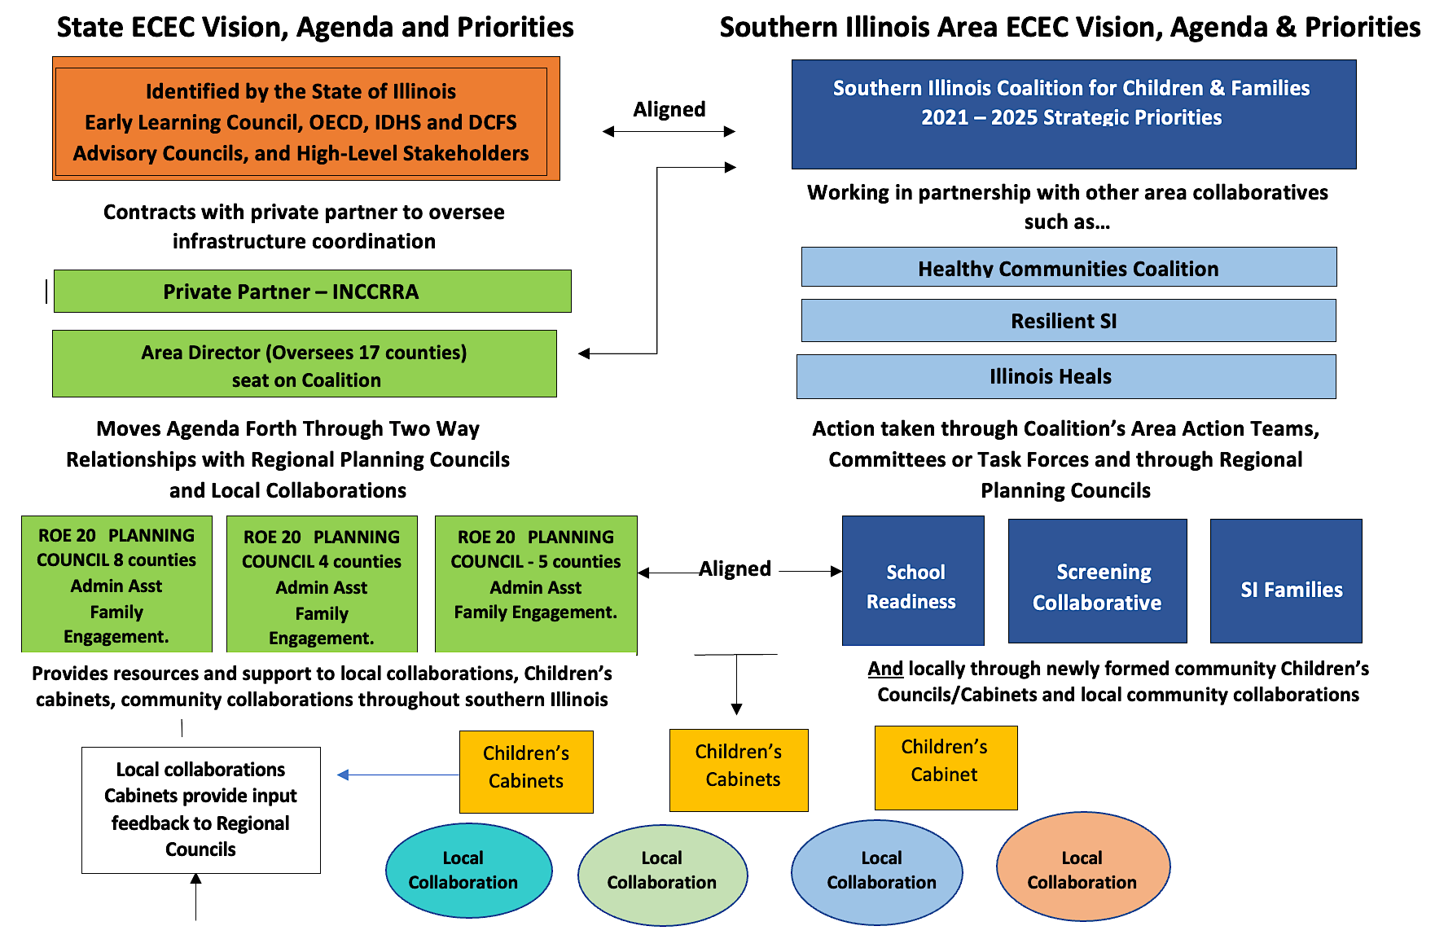

Illinois Regional & Community ECEC Systems Development Infrastructure
MISSION & PRINCIPLES
Utilizing a collective impact approach and with shared mission and values, the Community Systems Development Infrastructure will advance the state’s goal of administering an equitable and comprehensive early childhood system that values diversity and authentic family voice, empowering them to actively engage and inform decision-making and resource allocation
Objectives
Promote equitable access to programs & services through planning & coordination
Implement a better system to authentically engage & empower families & providers
Strengthening Families by connecting them to program & services
Create strong linkages across sectors that further improve results for children and families
INNOVTIVE
RESEARCH
AND
PRACTICE
Generate, leverage & sustain resources & supports for child-centered communities.
Create cross-sector systems of opportunity (for kids for families? )

Slide 5
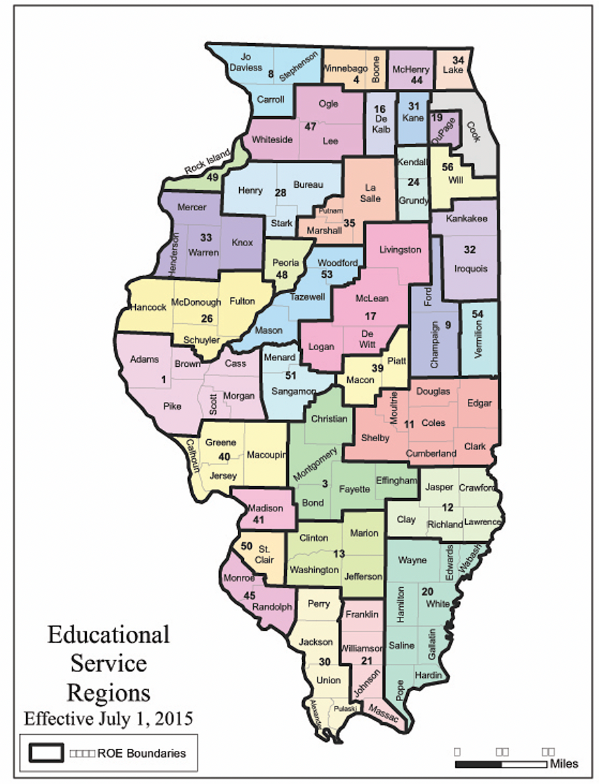
KEY INPUTS THAT REGIONAL COUNCILS WILL NEED
Input from parents on what they need and want
  Gathered from parents who do and who don’t currently participate in ECE
  Gathered through surveys, focus groups, and other methods
  Must be gathered within racial equity frame, and include families with children with special needs and those who speak a language other than English at home
Supply and demand data
  Demographic data, mapped
    Including K-1 enrollment by demographics, mapped
  Kindergarten readiness scores, disaggregated (and mapped, if possible, like EDI)
  Current capacity of providers, mapped
  Birth data, as recent as possible
Input from providers about what they need to better meet children’s/families’ needs

Slide 6
THE NEW STATE SYSTEM INFRASTRUCTURE AND SICCF
CHALLENGES | OPPORTUNITIES
Design needs to still recognize importance and strength of southern Illinois as a region, alignment with other regional efforts | Aligned with our mission and goals
Increasing competition within region | Addresses some challenges/ question of regional versus local, provides framework
Possible duplication of efforts/ conflicting efforts | Opportunity to leverage much needed resources ( people) to help coordinate the work and insure sustainability
Maintaining SICCF identity and leadership | Provides new legitimacy to the work and opportunity to engage new stakeholders
Confusion about Identity/ Roles | Because of our previous work and development, we are well poised to assist in the design and put the Coalition in a leadership role in how this will work in southern Illinois
2 additional counties in ROE districts
Accountability

Slide 7
QUESTIONS TO CONSIDER
Once SICC&F are determined, what is the best organizational structure to achieve our goals? (Action Teams? Committees, local collaborations? Different mechanisms for different priorities?)
What could/ should the connection be between the Coalition and the new infrastructure? (Formal? Informal? If informal, how can we make sure the work is connected?)
How can we best leverage the resources that will be brought to the region to further the Coalition’s goals?
If we could propose a design to the state for what the infrastructure could look in southern Illinois what would we like to see?
How can we best leverage the resources that will be brought to the region to further the Coalition’s priorities and goals?
Are there any local collaborations that already exist in the region? If so , where?
Does/can the Coalition have a role in helping launch Children’s Cabinets / Councils in local communities?

Slide 8
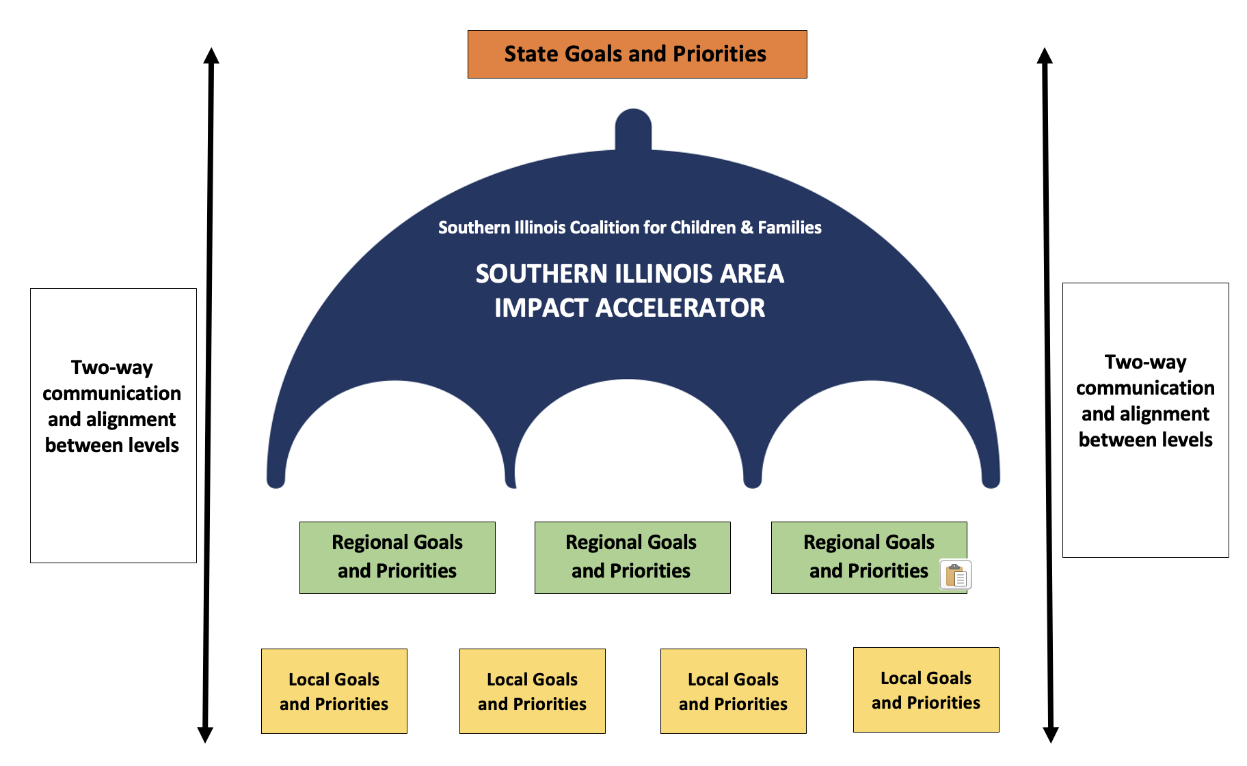
POSSIBLE FORMAL ROLE FOR SICC&F IN STATE INFRASTRUCTURE

Slide 9
SICC&F Strategic Priorities
GOALS & POSSIBLE OBJECTIVES

Slide 10
CRITICAL SHIFTS SICC&F SHOULD LEAD & IMPLEMENT v2
Attracting & retaining quality staff/workforce (linked to Male Caregivers & addressing existing waiting lists)
Universal definition of school readiness (include family involvement in this priority)
Effective co-ordination of services to support children (0-6) and their families (with involvement and leadership from family & a diversity of sectors)
Shared Understanding & Communication (requires a strengthening & updating of SICC&F’s communications infrastructure & consideration of who DIDN’T respond to the survey)
Monitoring and promoting developmental and social-emotional screening for all children in Southern Illinois
How do we revise SICC&F’s strategic priorities to reflect our dialogue re: the state ECEC system infrastructure?
Do we incorporate the Shared Understanding & Communication priority into a new priority re: developing the SI Area Impact Accelerator Role?
Do we create a 6th strategic priority re: developing the SI Area Impact Accelerator Role?

Slide 11
CRITICAL SHIFTS SICC&F SHOULD LEAD & IMPLEMENT- v3
Attracting & retaining quality staff/workforce (linked to Male Caregivers & addressing existing waiting lists)
Universal definition of school readiness (include family involvement in this priority)
Effective co-ordination of services to support children (0-6) and their families (with involvement and leadership from family & a diversity of sectors)
Shared understanding & communication of the value and importance of ECEC and strong families (across Illinois) (that: supports a culture shift; requires a strengthening & updating of SICC&F’s communications; considers those who DIDN’T respond to SICC&F survey; includes role development re: SI Impact Accelerator)
Monitoring and promoting developmental and social-emotional screening for all children in Southern Illinois

Slide 12
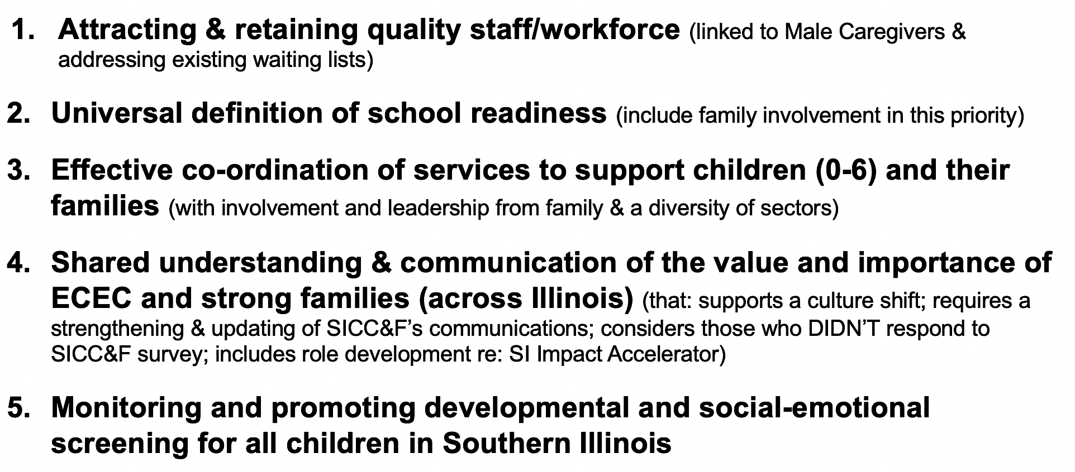
Critical Shifts SICC&F Should Lead & Implement - V3
Are there any critical shifts you would eliminate from this list?
Are there any you would add?
For each that are agreed on:
  What does success look like?
  What are the anticipated impact and outcomes?

Slide 13
Critical Shifts SICC&F Should Lead & Implement
Attracting & retaining quality staff/workforce (linked to Male Caregivers & addressing existing waiting lists)
GOAL: Ensure Southern Illinois has sufficient high-quality candidates to meet staffing needs in the early childhood education sector
POSSIBLE OBJECTIVES:
  Increase the number of qualified teachers available for the region’s ECE Programs
  Increased knowledge and application of teacher preparation models
  Greater understanding of the totality of roles teachers need to be prepared for
  Institutions for Higher Education are maintaining and investing in ECE teacher training
  Institutions for Higher Education monitor a broader set of metrics for ECE teacher training than simply # of students enrolled
  Better understand and address declining enrollment in existing ECE Teacher training programs.
  High school ad post-secondary education in ECE exist and are strongly invested in
  Quantitatively look at salaries for ECE Teachers in order to define/quantify the gaps
  Salaries for ECE Teachers are competitive with other sectors and industries
  To encourage retention, all levels of the educational continuum are promoted
  Research regarding professional development pathways for ECE teachers have been highlighted and shared with key audiences
Notes:
Universal definition of school readiness (includes family involvement in this priority)
Effective Co-ordination to Effectively Support Children (0-18) and their Families
Communication (which requires a strengthening & updating of SICC&F’s communications infrastructure Review & consideration of who DIDN’T respond to the survey
Monitoring and promoting developmental and social-emotional screening for all children in Southern Illinois

Slide 14
Critical Shifts SICC&F Should Lead & Implement
Universal definition and shared commitment to ensuring school readiness for all children (include family involvement in this priority)
GOAL: All children arrive at school ready to learn and there is a community-wide commitment to supporting this goal. Regional offices, school districts, ECE stakeholders and families have a universal definition of school readiness with clear, tangible examples and consistent assessment tools. Different pathways have been identified to support and enable families to ensure young children to arrive at school ready to learn.
POSSIBLE OBJECTIVES:
  There is strong community involvement in supporting the goal of child readiness
  Our local strategies and approaches have researched and leveraged promising strategies and resources from other jurisdictions
  New innovative approaches are identified, piloted and shared that make it easier/simpler to support families in promoting child readiness
  A diversity of community partners have identified pathways and supports that ensure all children arrive at school ready to learn
  Families and community partners are knowledgeable about readiness expectations for children starting school and how it lays a foundation for success throughout their school careers
  Knowledge and strategies supports needed to ensure that all children have a successful transition to school are identified and communicated
Notes:
Universal definition of school readiness (includes family involvement in this priority)
Effective Co-ordination to Effectively Support Children (0-18) and their Families
Communication (which requires a strengthening & updating of SICC&F’s communications infrastructure Review & consideration of who DIDN’T respond to the survey
Monitoring and promoting developmental and social-emotional screening for all children in Southern Illinois

Slide 15
Critical Shifts SICC&F Should Lead & Implement
Effective co-ordination of services for children (0-6) and their families
GOAL: Families are strong and engaged in their child’s lives and learning with access to information, services and support they need to help their child succeed.
Objectives:
Engage families in new ways to determine needs and barriers to services Provide opportunities for families to network, share information and support on another Create a regional (community) system that uses a variety of methods and means to connect families with valuable resources* in their communities Explore implementing a regional (community) Community Resource Network, a tiered approach to provide information/referrals to programs and agencies Explore innovative options to connect southern Illinois families with resources through technology and maximize already existing resources including 211, HSIDN Resource Guides, family resource guides, etc. Identify the programs and services children and families need to access to be healthy and strong | Advocate to fill service gaps Provide cross training/information to agency/program staff so they are aware of what is available for families in their communities Provide networking/professional development opportunities/Community of Practice for family resource workers/specialists to increase knowledge and improve practices Explore/develop a central repository for information on programs and services that supports young children and their families Utilize media to inform families of available programs and services, family resource website, social media Create a regional system that uses a variety of methods and means to connect families with valuable resources* in their communities – local children’s cabinets, community resource network Create and coordinate a community resource network Explore expanding use of IRIS (currently being used at Egyptian Health)
Notes:
Universal definition of school readiness (includes family involvement in this priority)
Effective Co-ordination to Effectively Support Children (0-18) and their Families
Communication (which requires a strengthening & updating of SICC&F’s communications infrastructure Review & consideration of who DIDN’T respond to the survey
Monitoring and promoting developmental and social-emotional screening for all children in Southern Illinois

Slide 16
Critical Shifts SICC&F Should Lead & Implement
Create a strong communication system to reach families, community members and stakeholders by their preferred method in order to build relationships, work collaboratively and share information (in Illinois’ southern fifteen counties)
GOAL: To generate communications that support public understanding and universal commitment regarding the importance & value of ECEC and strong families and the importance of a sustained culture shift to ensure that this becomes a reality.
POSSIBLE OBJECTIVES:
  Determine the best way(s) to connect with a diverse population of families, including ‘hard to reach’ families
  Create a comprehensive list of contacts that have an interest and/or commitment in the Coalition’s work
  Cast a wide net to encourage participation when Action Teams get under way
  Initiate and/or Strengthen relationships with stakeholders in targeted communities, spreading out to more communities as capacity allows.
  Review the Coalition’s Vision and Goals annually (I mean review it to refresh/center efforts – not review to change it)
  Include the Coalition Vision and Goals on letterhead, emails from the Coalition, etc.
Notes:
Universal definition of school readiness (includes family involvement in this priority)
Effective Co-ordination to Effectively Support Children (0-18) and their Families
Communication (which requires a strengthening & updating of SICC&F’s communications infrastructure Review & consideration of who DIDN’T respond to the survey
Monitoring and promoting developmental and social-emotional screening for all children in Southern Illinois

Slide 17
Critical Shifts SICC&F Should Lead & Implement
Coordinate, Support & Promote Developmental and Social-Emotional Screening and Referral Systems (in S. Illinois)
GOAL: All children ages birth through five are screened for developmental and social emotional delays.
Objectives:
SCREENING |  | REFERRALS | DATA
Facilitate a community of practice for regional screening partners Inform and educate new partners, adopt common language, approved screening tools and benefits of implementation Coordinate training, technical assistance that supports best practice screening and referral Raise public awareness of screening through health airs, libraries, community events and hospitals and social media Support increased development screening of children, birth through age 5, by early education providers and other community partners Increase the number of childcare providers that screen children for developmental and social/emotional delays | Ensure providers have the tools and skills to recognize children who may be at risk of a developmental delay or behavioral issue and know how provide the appropriate referrals Explore options and models to increase availability of screenings between Child Find and organized screening Improve processes for screening reporting to EI inform and educate new partners, adopt common language, approved screening tools and benefits of implementation Organize/ support community screening events Support screeners to use screening results to promote school readiness, both in the home and childcare setting | Improve processes for screening reporting to EI Build relationships with referral agencies and establish and approve protocols for each Provide training and tools to providers on the referral process Connect healthcare providers to referral agencies and establish protocols Connect with B-5 early childhood mental health agencies to discover services provided, referral protocols, etc. Connect programs to B-5 mental health agency information (referral and services) | Gather and analyze screening data to identify gaps for targeting efforts and measuring success Inform partners of how new information will be gathered and placed in system Raise public awareness of screening through health airs, libraries, community events and hospitals
Notes:
Universal definition of school readiness (includes family involvement in this priority)
Effective Co-ordination to Effectively Support Children (0-18) and their Families
Communication (which requires a strengthening & updating of SICC&F’s communications infrastructure Review & consideration of who DIDN’T respond to the survey
Monitoring and promoting developmental and social-emotional screening for all children in Southern Illinois

Slide 18

Insights?
Comments?
Questions?

Slide 19


